Slide 1
CNN For Sentence Clasification Deep Learning Course Project
Prateek Yadav
UG Mathematics Major
2nd Year

Slide 2
TOPICS COVERED IN THIS PRESENTATION
Description of the Model
Model Variations
Breakdown Into Major Tasks
Implementation Steps
Challenges Faced
Comparison of Results
Tasks Accomplished

Slide 3
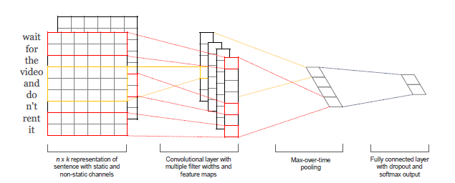
DESCRIPTION OF THE MODEL
Similar to a Convolutional Neural Network
Applying Filters of Variable Width
Filters are 1-D
Max over time Pooling
Fully connected Softmax Layer (with Dropout)

Slide 4
MODEL VARIATIONS
Word are loaded from Word2Vec
Static: The Loaded Vectors are kept fixed throughout the training
Non-Static: The Loaded Vectors are fine tuned according to the vocabulary of the document
Random: Word Vectors are initialised randomly and learned during training
Multi Channel: Two parallel channels are created both initialised by word2vec, one is kept static and the other one is fine tuned. Same filters are applied to both channels and the average value is taken.

Slide 5
BREAKDOWN INTO MAJOR TASKS
Understanding the Paper
Readings related to NLP
Learning Torch, Lua, numpy and familiarity with other basic packages
Implementation
Debugging
Training And Testing Models

Slide 6
Natural Language Processing
Vector Representation of Words(one-hot, word2vec)
Document Preprocessing
Semantic Relationships between Words
N-gram models
Next word Predictor

Slide 7
SKILLS DEVELOPED
Linux Os: using terminal to access a remote server to run model training.
LUA: learned lua to work with torch7 and cuda-torch package
Torch: familiarity with Torch tensors, convolutions and LookupTables, Torch Graphs, Internal Data Representation In Torch, Convolution and Cross Correlation,
Numpy, word2vec, ggplot, matplotlib, pandas, cuda, openCL, Tried Tensorflow and Theano.

Slide 8
IMPLEMENTATION
Data Preprocessing (word-index, vectors, padding, splitting data sets)
HDF5 dataset files
Train Class
Test Class
Model Classes
Saving Models
Moving training on GPU

Slide 9
DEBUGGING
A lot of errors were obtained, as this was the first big project I worked on
Most of the errors were in the classes that I created. The object was created but the class returned nothing.
Such errors were resolved through an effort spanning 3 complete days.

Slide 10
CHALLENGES FACED
Installing all the required packages on Linux system
Learning many new languages and packages in a short period of time
Designing the classes and preprocessing data
Training the data on CPU and modifying the complete code to run on a GPU
Training the model on a remote system
Notes:
Anaconda was helpful
Documentation, youtube tutorials,
Sample examples, documentation, stackoverflow, google mailing groups

Slide 11
TRAINING AND TESTING
For Datasets containing Test set, training was done normally, on complete training data
For Datasets containing only the Train set, I did a 10 fold Cross Validation(CV), which provided training and test set accuracies.

Slide 12
DATASETS
MR: Movies Review (positive/negative)
SST-1: Extension of MR by stanford (very positive, positive, neutral, negative, very negative)
SST-2: Same as SST1 but no neutral reviews
SUBJ: Classify a problem as subjective or objective
TREC: Question dataset (about person, location, etc)
CR: Customer Review (positive/negative)
SST-1 and SST-2 contained a Train and Test set while other had just the Train Set.

Slide 13
HYPERPARAMETERS AND METHODS
Regularization: L2 norms
Filter width: {3,4,5}
Number of feature maps: 100
Dropout Rate: 0.5
Batch Size: 50
10 Fold CV
Google word2vec vectors
Stochastic Gradient Descent (Adadelta update rule)
Notes:
Anaconda was helpful
Documentation, youtube tutorials,
Sample examples, documentation, stackoverflow, google mailing groups

Slide 14
COMPARISON OF RESULTS
Model | CNN-rand |  | CNN-static |  | CNN-non-static
MR | 75.91 | 76.1 | 81.40 | 81.0 | 81.12 | 81.5
SST-1 | 42.77 | 45.0 | 45.04 | 45.5 | 44.14 | 48.0
SST-2 | 82.91 | 82.7 | 83.14 | 86.8 | 84.34 | 87.2
SUBJ | 89.81 | 89.6 | 91.20 | 93 | 91.58 | 93.4
TREC | 90.56 | 91.2 | 91.21 | 92.8 | 91.61 | 93.6
CR | 79.58 | 79.8 | 79.79 | 84.7 | 79.35 | 84.3
MPQA | 84.96 | 83.4 | 85.09 | 89.6 | 85.36 | 89.5
Left column: Result obtained in my Implementation
Right Column: Result published in paper

Slide 15
TASKS ACCOMPLISHED
Successful Implementation of the model
Rand, Static, non-static variants
Trained and tested on all datasets
Accuracies are close enough
Multichannel was not Implemented as initially it introduced lots of errors to the code, then Sir said I can leave it.
Notes:
Anaconda was helpful
Documentation, youtube tutorials,
Sample examples, documentation, stackoverflow, google mailing groups

Slide 16
THANKS!
Any questions?

